Slide 1
ModuLoop
Team 28 MDR: Conor Curtin, Evan Rovelli, Ryan Gordon, Shawn Colby
Advisor: Baird Soules
Evaluators: Professor Anderson & Professor Lorenzo
Notes:
Handout - 2 slides/page

Slide 2

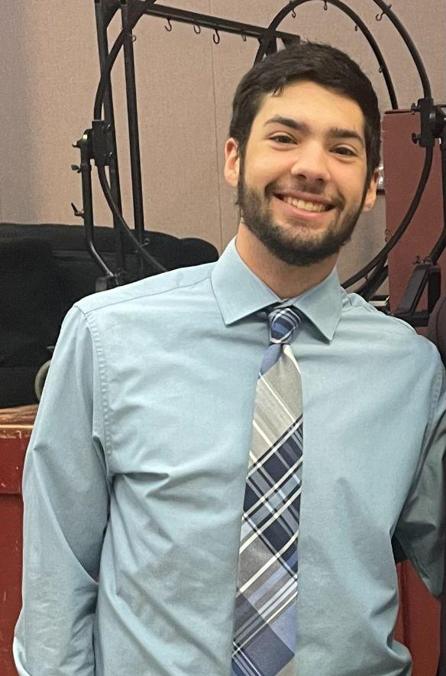


Team
Shawn Colby
Computer Engineering
Ryan Gordon
Electrical Engineering
Conor Curtin
Computer Engineering
Evan Rovelli
Computer Engineering

Slide 3
Problem Statement
Music creation has evolved over time and a lot of new technology has been incorporated into this process. There are many solutions designed to create backbeats and loops to aid musicians in creating music. However, a lot of these tools only have set features and are quite confusing for an inexperienced user to operate.
We have decided to design a solution that is more modular in its features and easier for the user to operate. Our device will be able to have varying steps for each beat in a looping measure. There will be different sounds and effects that can be swapped by the user to achieve various styles of music. The loops will be chainable, so multiple measures of music can be made.
Notes:
Ryan

Slide 4

Goal
We aim to develop a music sequencer that can use custom imported sounds along with sounds from a MIDI library to provide a user friendly, handheld platform used as a creative tool early in the production process of making music.
Notes:
Shawn

Slide 5
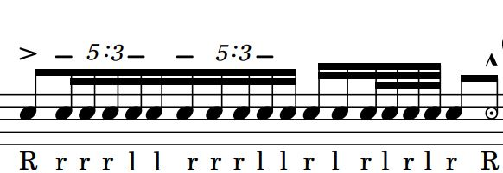
Terminology
Step - Moment in time when sound is output
Beat - Combination of one or more steps of equal length in succession
Measure - A collection of one or more beats in succession
Loop - A collection of one or more measures that is repeated
Tempo - The frequency at which beats occur in beats per minute (BPM)
MIDI - Standardized protocol & instrumentation library without defined sounds for music-making devices
General MIDI - Standardized instrumentation library with defined sounds
Notes:
Conor

Slide 6
Specifications
Specification | Test Plan
Produce accurate tempo down to smallest step within +/- 2% | Measure delay between steps and test against metronome timing for accuracy
Achieve four sounds layered at once | Mix minimum four sounds concurrently
High and low pass filters can be applied to final mix | Read effect of HPF & LPF in frequency domain using FFT oscilloscope feature
Allow user interchangeable custom sound files | Play custom sound files from external storage
Preset and custom sounds can be mixed together | Output mixed preset and custom sounds
Notes:
Evan
(3.33 ms) @ 60 BPM - 6 step beat

Slide 7
Specifications Cont.
Specification | Test Plan
Graphical user interface can be used to navigate preset & custom sound libraries and saved pattern configs | Navigate sound libraries and saved configurations
BPM is adjustable through a user input | Cross check multiple BPM inputs with a metronome to confirm continuity
System outputs to wired or built-in speakers | Display system sound through headphones or speakers
System is operable by both rechargeable battery and power supply | Independently demonstrate system powered from external power supply and battery
Device under the dimensions of a large tablet (under 13x13 inches) | N/A
Notes:
Evan

Slide 8


MDR Deliverables
System built on breadboards & development boards
Audio sources implemented (MIDI & SD)
Preliminary display & user interface
Looping & palette buttons configured
Demonstrate one measure looping continuously
Ability to play one MIDI & one SD sound individually on each step
Analog mixing one MIDI & one SD sound on the same step
Effects overlay design
High pass & low pass filters designed, implemented
Battery management system designed
Notes:
Move earlier before we talk about what we did

Slide 9
Missed Deliverables Explanation and Progress
Effects overlay design - Most of our focus was on getting the sounds to play for MDR instead of adding effects to those sounds so we determined this would be a step for CDR.
High pass & low pass filters designed, implemented - We implemented 1st order Butterworth RC circuits as low and high pass filters. These filters modulate the sound, but they don’t isolate low and high frequencies as we would expect.
Battery management system designed - We have done research into different options for rechargeable batteries and have decided that we want to use LiPo batteries.
Notes:
Conor
Also move earlier with the deliverables

Slide 10
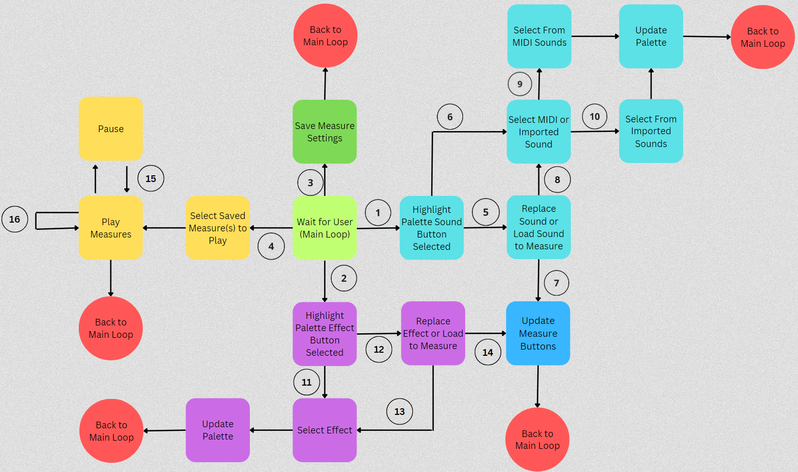
Software Block Diagram
Key
Palette sound button pressed
Palette effects button pressed
Save button pressed
Select measure button
If selected button memory already contains a sound
If button memory doesn’t contain a sound
Load sound to measure
Replace sound in palette
Select MIDI
Select imported
Button memory doesn’t contain an effect
Button memory does contain an effect
Replace effect in palette
Load effect to measure
Pause button is pressed
Measures loop once play button pressed until paused
Notes:
Shawn
Cache that answer Shawn

Slide 11
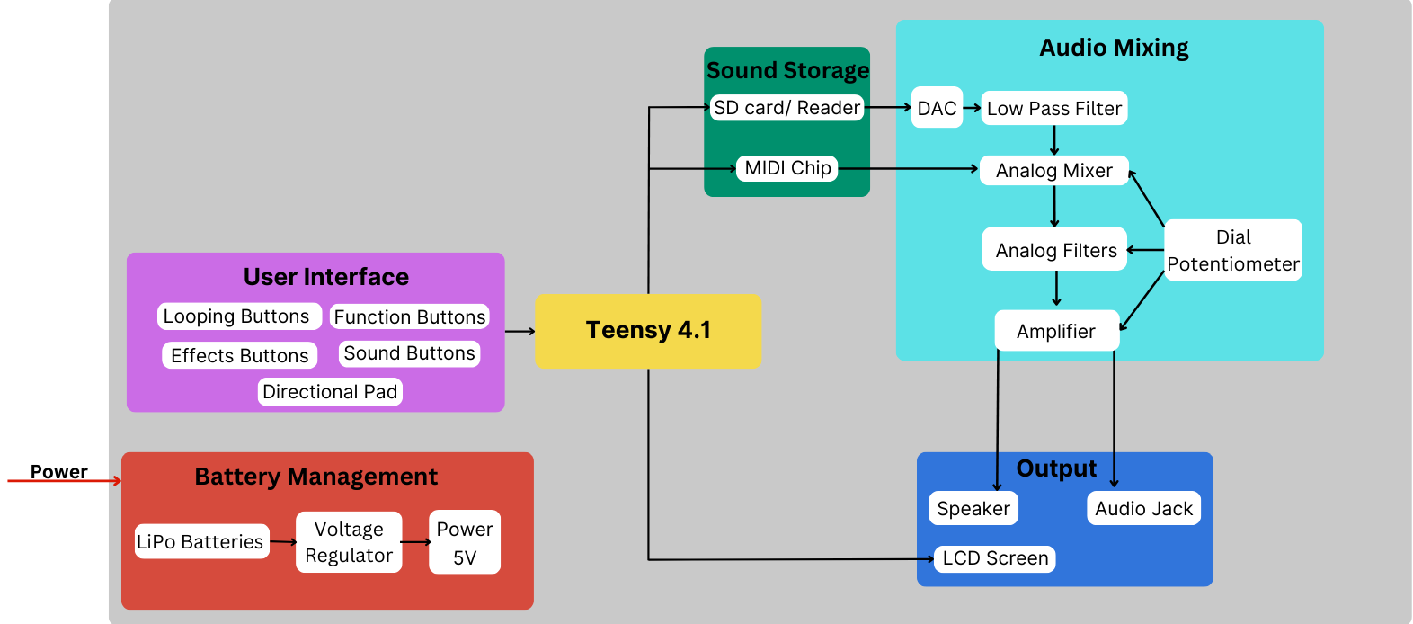
Hardware Block
Diagram
Notes:
Ryan

Slide 12
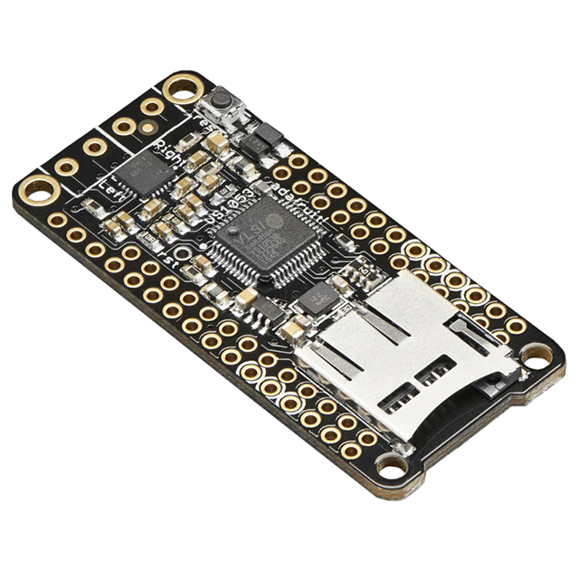
VS1053b - MIDI Audio Codec Circuit
IC implementing General MIDI sound library
128 Melodic Sounds (GM1)
60 Percussion Sounds (GM1 & GM2)
Sound banks available through serial connection
Order of Commands (Melodic)
Select Sound Bank
Select Instrument
Activate Pitch
Order of Commands (Percussion)
Select Sound Bank
Select Default Instrument
Activate Percussive Instrument
Notes:
Conor

Slide 13
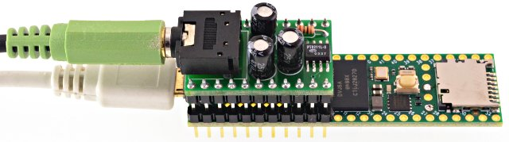
Custom Sounds
Integrated SD card reader
Store raw audio format (.WAV)
Navigable by GUI
PT8211 DAC
44.1 kHz 16 bit data
Interfaces over I2S
Digital sound file mixing
Notes:
Evan

Slide 14
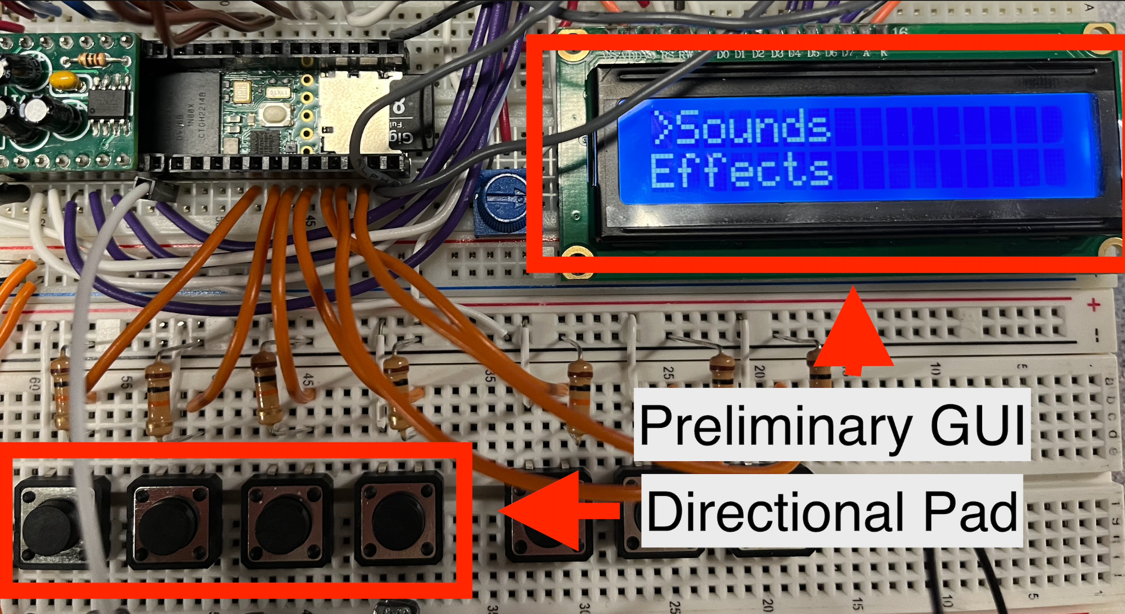
Preliminary Display
Graphical User Interface
Navigate effect & sound libraries
MIDI & Custom Sounds
Directional Pad
Scroll & select options
custom sound1
custom sound2…
Custom Sounds
Sounds
MIDI Sounds
midi sound1
Effects
effect1
midi sound2…
effect2…
Notes:
Evan

Slide 15
Timing and Looping
Has our selected time range elapsed?
Yes
If statements for each step
Teensy 4.1 has its ARM Cortex-M7 clocked at 600 MHz!
Utilizing this fast clock speed can allow us to perform all functions needed within each step before changing to the next step
Set up a time range we want our steps to last for and check if that time has passed
No
Other checks for buttons like control panel
Update step variable
Notes:
Shawn
Look more at millis() and how the Metro library functions
Label exits for time elapsed box

Slide 16
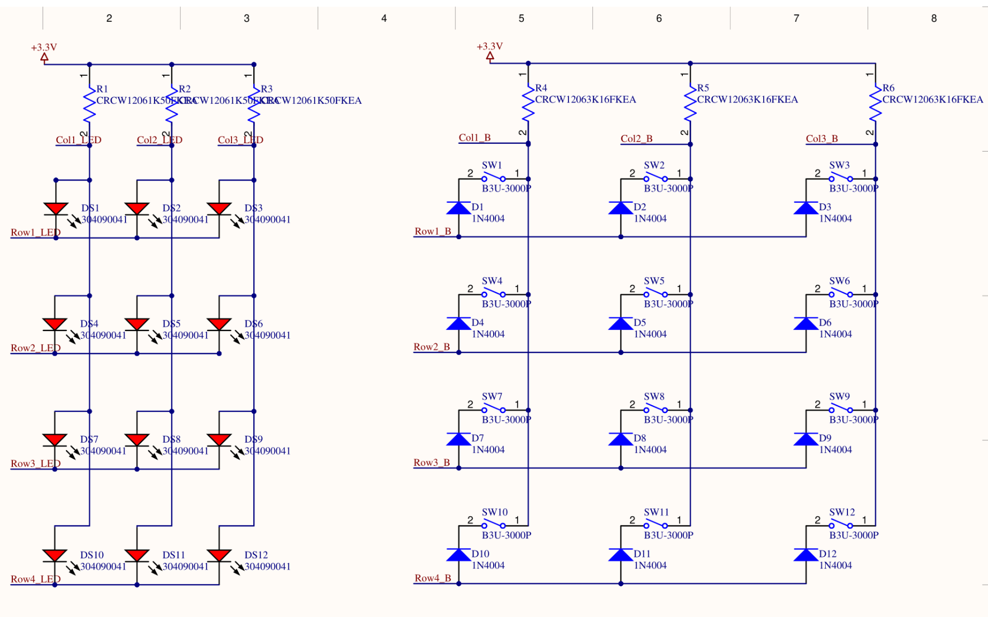
PCB Schematic
Diodes protect buttons from a false button push
Buttons are detected through grounding of the rows
LED activated by setting the column high and the row low
Notes:
Ryan
Bigger schematic
How it relates to MDR deliverables

Slide 17
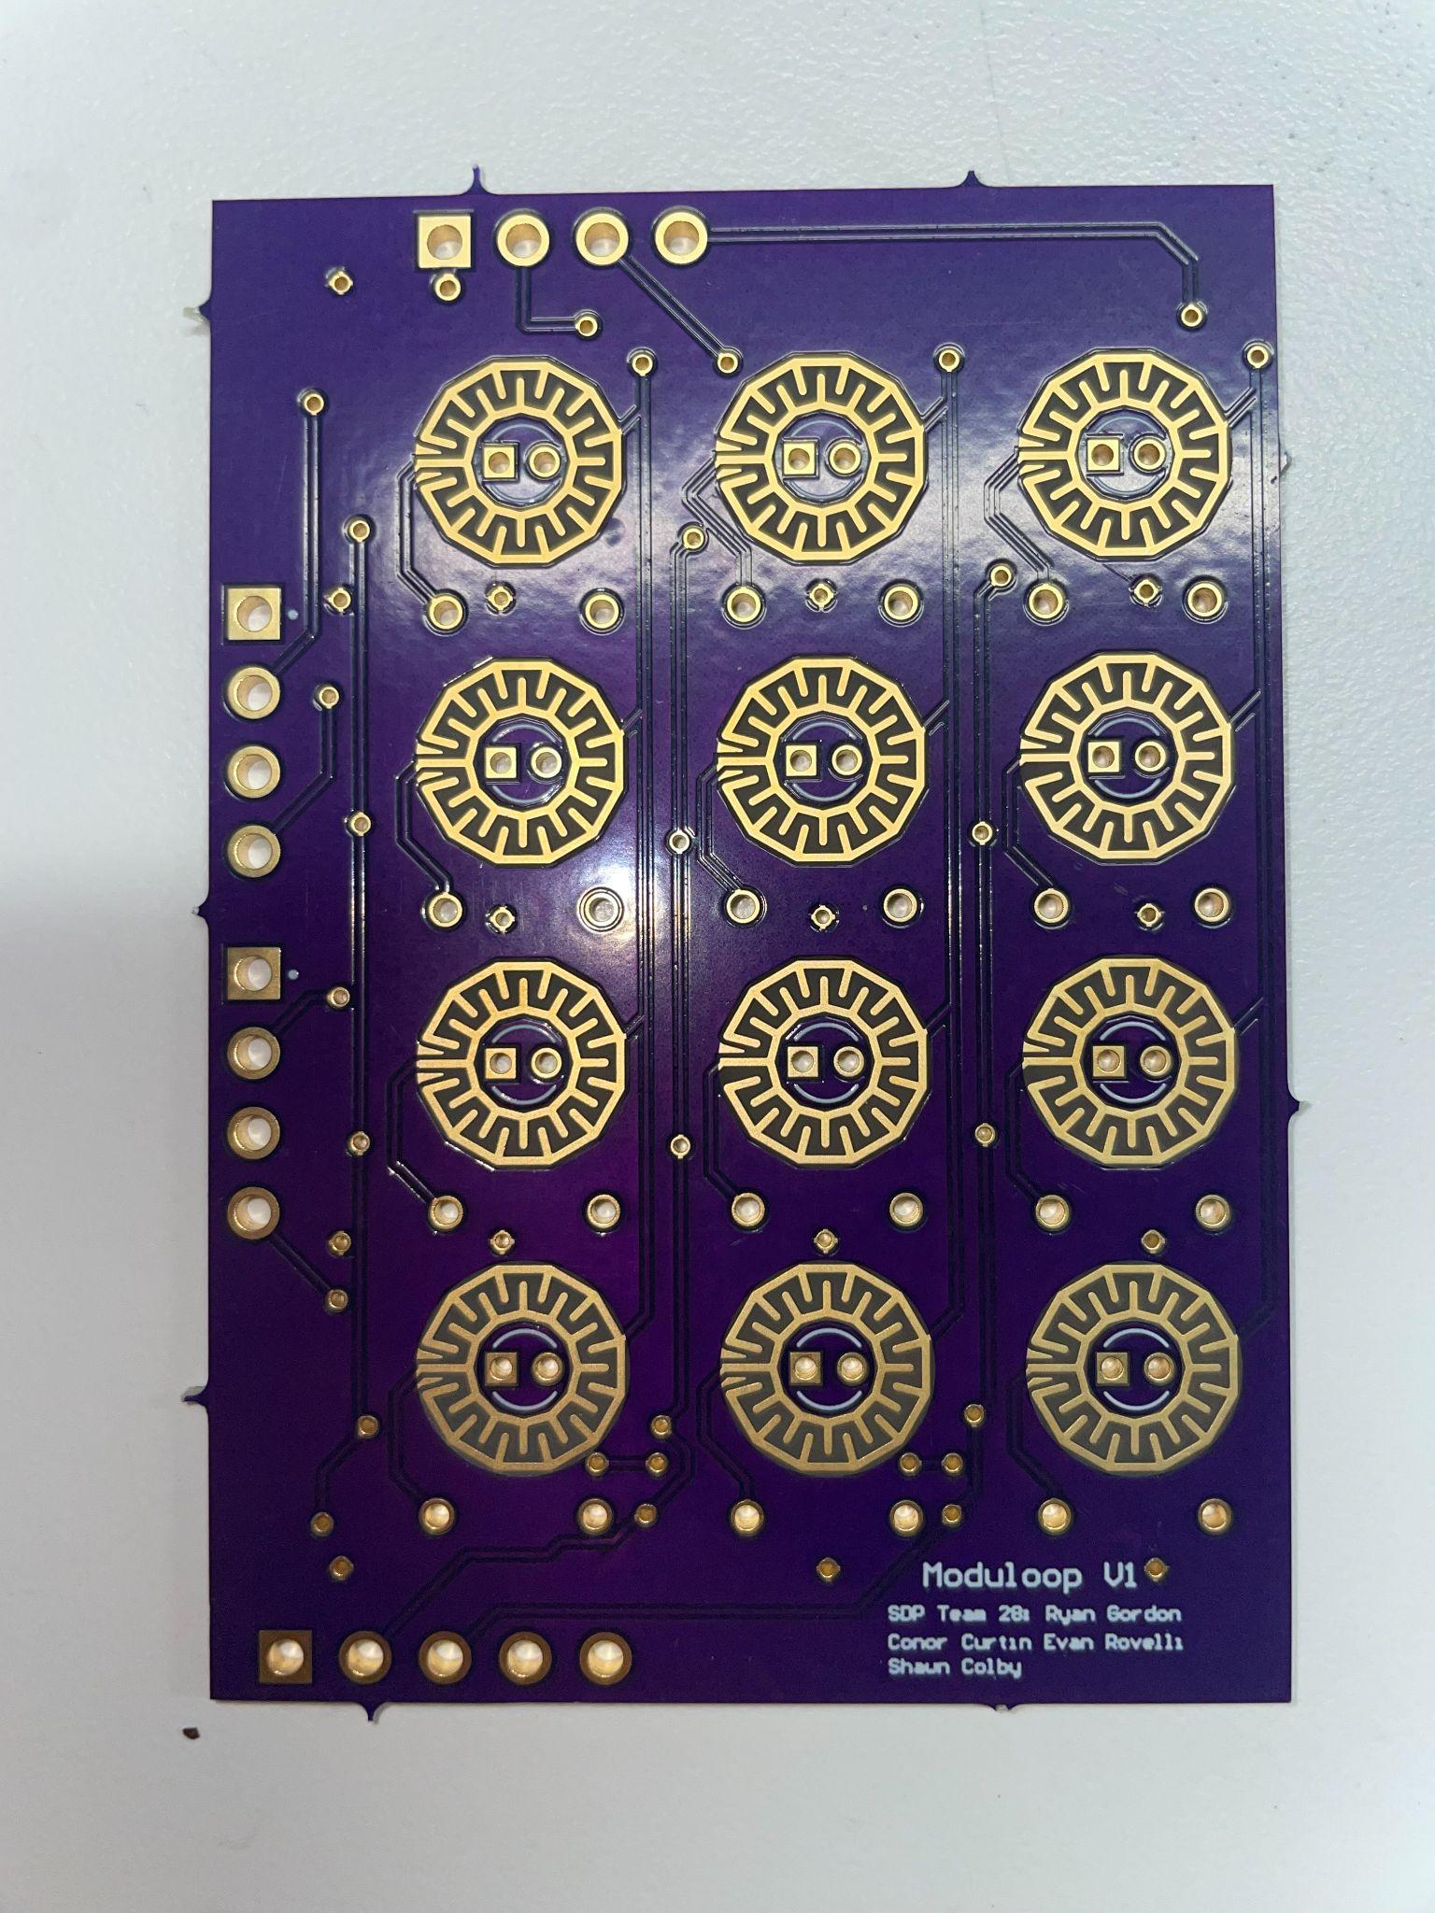
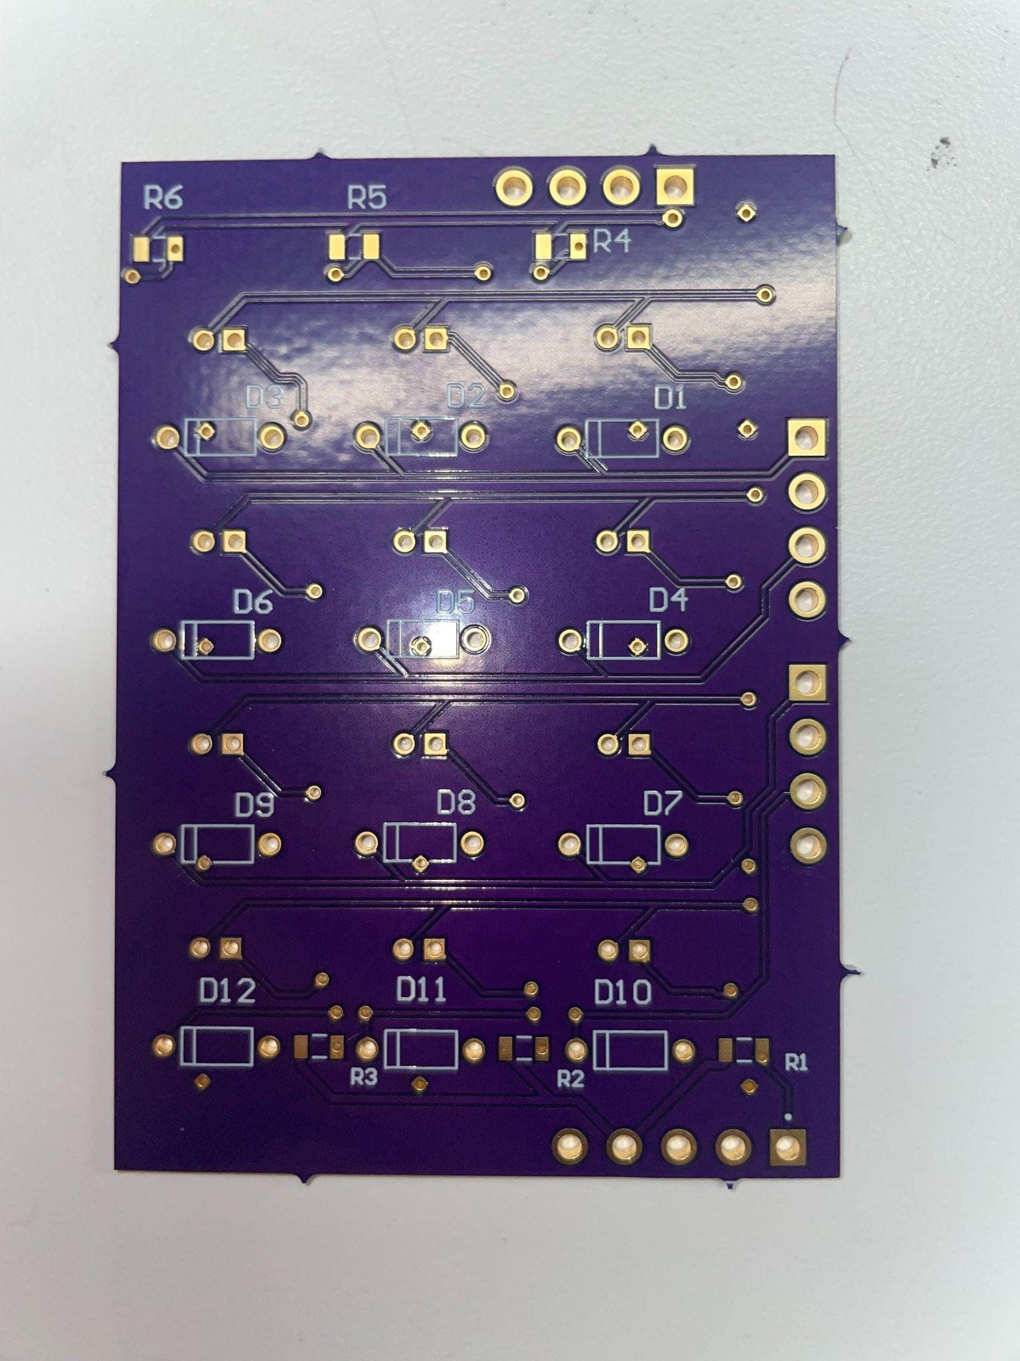
PCB Design
Designed in Altium
Worked with a previous senior design project and Adafruit PCB files
Custom button pads
Notes:
Ryan

Slide 18
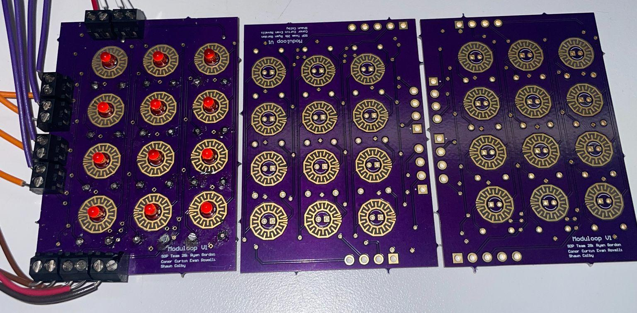
PCB Update and Changes
We moved away from one large PCB to three identical smaller PCBs
More cost efficient
Easier troubleshooting
Screw Terminal blocks used for headers
Notes:
Ryan
Screw Terminal Block
siliCONE

Slide 19
Audio Systems
Amplifier, Audio Mixer, Low/High pass filter
LM386 IC for the amplifier
TL072CP op amp for mixing multiple audio signal
Potentiometer for variable resistance to control volume and tune frequency range
We have encountered a noticeable amount of noise when hooking these components on breadboards.
More testing will be done to tune the noise and achieve the results we are looking for
Notes:
Ryan
Look at power, measure the power, check for noise
Label the breadboards somehow
Potentially add PT8211 - Teensy DAC

Slide 20
CDR Deliverables
Full 6x4 Measure Matrix on PCB
LEDs demonstrate which step is currently being played
Buttons utilized to assign sound to specific step
Full 3x4 Palette on PCB
LEDs to show which Palette location selected
Buttons utilized to quickly access device
Display UI
Select # of steps active for a specific measure
Assign sounds to Palette
Set Tempo
Notes:
Conor

Slide 21
CDR PCB
Button Matrix PCB
Modifying pinouts to normal headers
Add mounting holes for connecting PCBs
Separate PCB for audio devices
Teensy 4.1
Music Maker Featherwing
Audio Mixer
Amplifier
Low pass/ High pass filters
Direction Pads
Multiplexing for LEDs and buttons
Notes:
Evan

Slide 22
CDR Prototype Demonstration
Complete the entire process of creating a measure matrix from scratch
Use the LCD display to select MIDI sounds, SD sounds, and effects
Assign sounds and effects to palette
Populate measure matrix using the sounds and effects on the palette
Overlap SD sounds and MIDI sounds on the same step to highlight ability to mix sounds
Use the LCD display to display the tempo
Use the LCD display to change the number of active steps in a beat
Notes:
Shawn

Slide 23
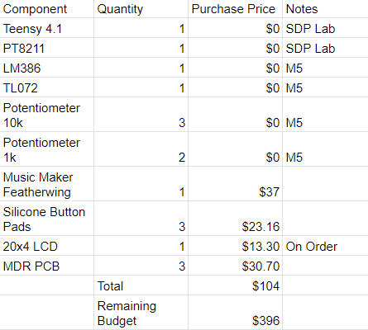
Budget
Notes:
Conor

Slide 24
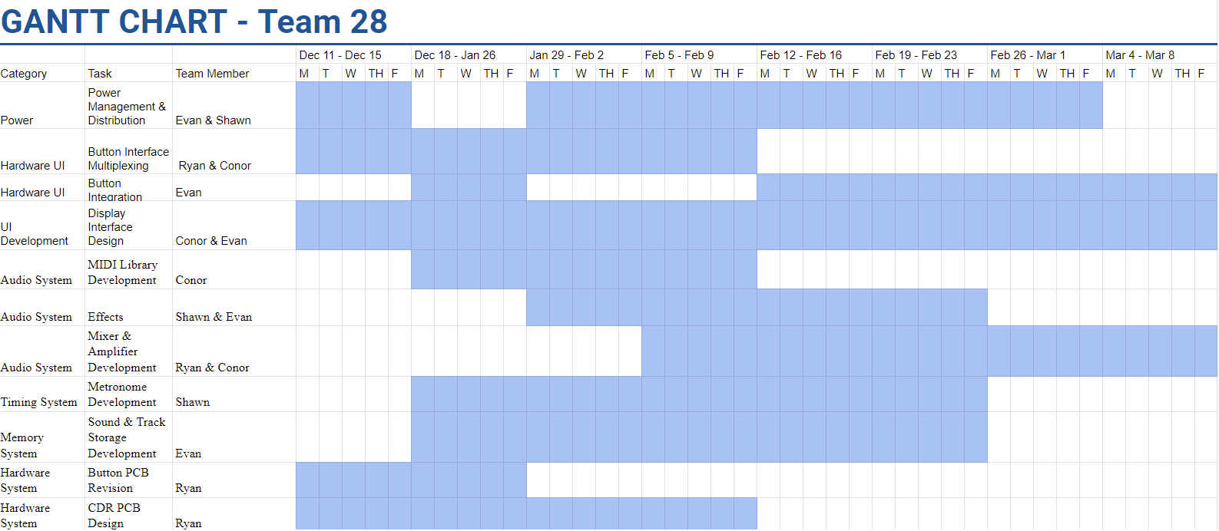
Gantt Chart
Notes:
Conor

Slide 25
MDR Deliverables
System built on breadboards & development boards
Audio sources implemented (MIDI & SD)
Preliminary display & user interface
Looping & palette buttons configured
Demonstrate one measure looping continuously
Ability to play one MIDI & one SD sound individually on each step
Analog mixing one MIDI & one SD sound on the same step
Effects overlay design
High pass & low pass filters designed, implemented
Battery management system designed

Slide 26
Any Questions?
Notes:
Block diagram during questions
Write microcontroller
Goal-mention inspiration
Louder demo

Slide 27
References
VS1053b Featherwing: https://www.digikey.com/en/products/detail/adafruit-industries-llc/3436/6827175?utm_adgroup=&utm_source=google&utm_medium=cpc&utm_campaign=PMax%20Shopping_Product_Low%20ROAS%20Categories&utm_term=&utm_content=&utm_id=go_cmp-20243063506_adg-_ad-__dev-c_ext-_prd-6827175_sig-Cj0KCQiA67CrBhC1ARIsACKAa8QEArGkCWevP-5P9yz5e55PLQo6WcaafG6eP_CFS0Q_fKx7r4HIl68aAutdEALw_wcB&gad_source=1&gclid=Cj0KCQiA67CrBhC1ARIsACKAa8QEArGkCWevP-5P9yz5e55PLQo6WcaafG6eP_CFS0Q_fKx7r4HIl68aAutdEALw_wcB
Silicone Elastomer 4x4 Button Keypad:
https://www.adafruit.com/product/1611?gclid=CjwKCAjw1t2pBhAFEiwA_-A-NDTtT1Fv0Pom-Xa1PDR7qwdU8NqKZW9lCUjbFF08cc-PaoZ68PYBrxoC1QAQAvD_BwE

Slide 28

MDR System Demo

Slide 29
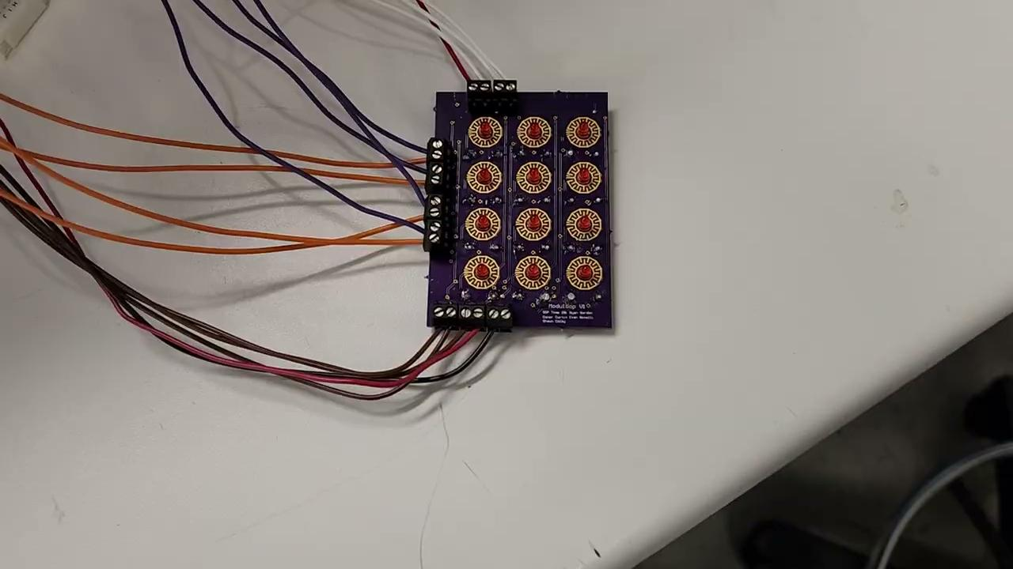
MDR PCB Demo

